Slide 1

SDET Course
Design Patterns - Introduction

Slide 2
Why??
Code readability and efficiency
Improves communication
Improves code quality
Good software design practices
Notes:
Code Reusability and Efficiency: Design patterns provide time-tested solutions to common problems encountered in software design. By learning these patterns, developers can reuse these solutions rather than reinventing the wheel. This leads to more efficient coding and reduces the time spent on solving already-solved problems.
Improved Communication: Design patterns offer a common vocabulary for developers to describe solutions in a more concise and standardized manner. When a developer mentions a specific pattern like Singleton or Observer, other developers familiar with design patterns can quickly understand the proposed solution's structure and intent. This facilitates better communication within the team and improves collaboration.
Enhanced Code Quality: Using design patterns can lead to more robust and flexible code. Patterns like Factory, Abstract Factory, and Builder, for example, encourage decoupling and the principle of programming to interfaces rather than implementations. This results in code that is easier to maintain, test, and extend, leading to overall improved software quality.
Facilitates Good Software Design Practices: Learning design patterns helps in understanding the importance of good software design principles such as SOLID principles. These patterns often embody these principles, demonstrating their practical applications and teaching developers how to apply them in real-world scenarios.

Slide 3
3 Types of Design Patterns
Creational - These patterns are all about class instantiation or object creation. They can be further divided into class-creation patterns and object-creational patterns.
Structural - These patterns deal with object composition or the structure of classes. They help ensure that if one part of a system changes, the entire system doesn't need to do the same.
Behavioral - These patterns are all about class's objects communication. They help define how objects interact in a way to increase flexibility in carrying out communication.

Slide 4
3 Types of Design Patterns
Creational
Singleton
Builder
Prototype
Factory Method
Abstract Factory
Structural
Adapter
Composite
Proxy
Flyweight
Bridge
Facade
Decorator
Behavioral
Strategy
Observer
Command
Memento
State
Template Method
Mediator
Chain of Responsibility
Interpreter
Visitor
Iterator

Slide 5
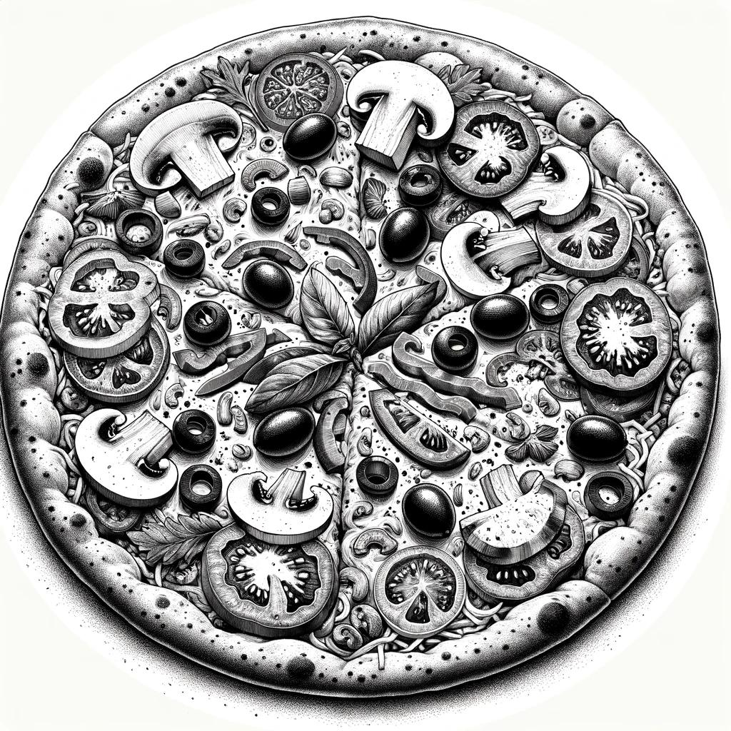

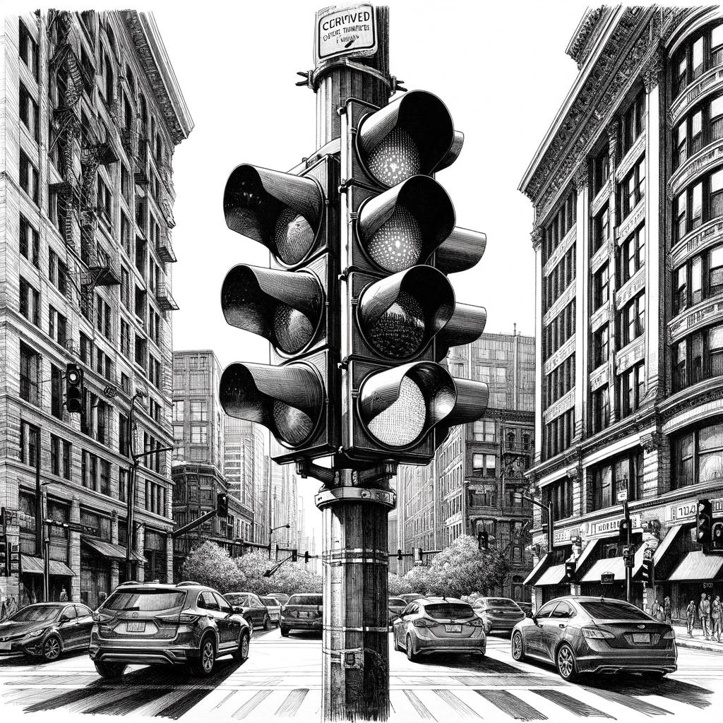


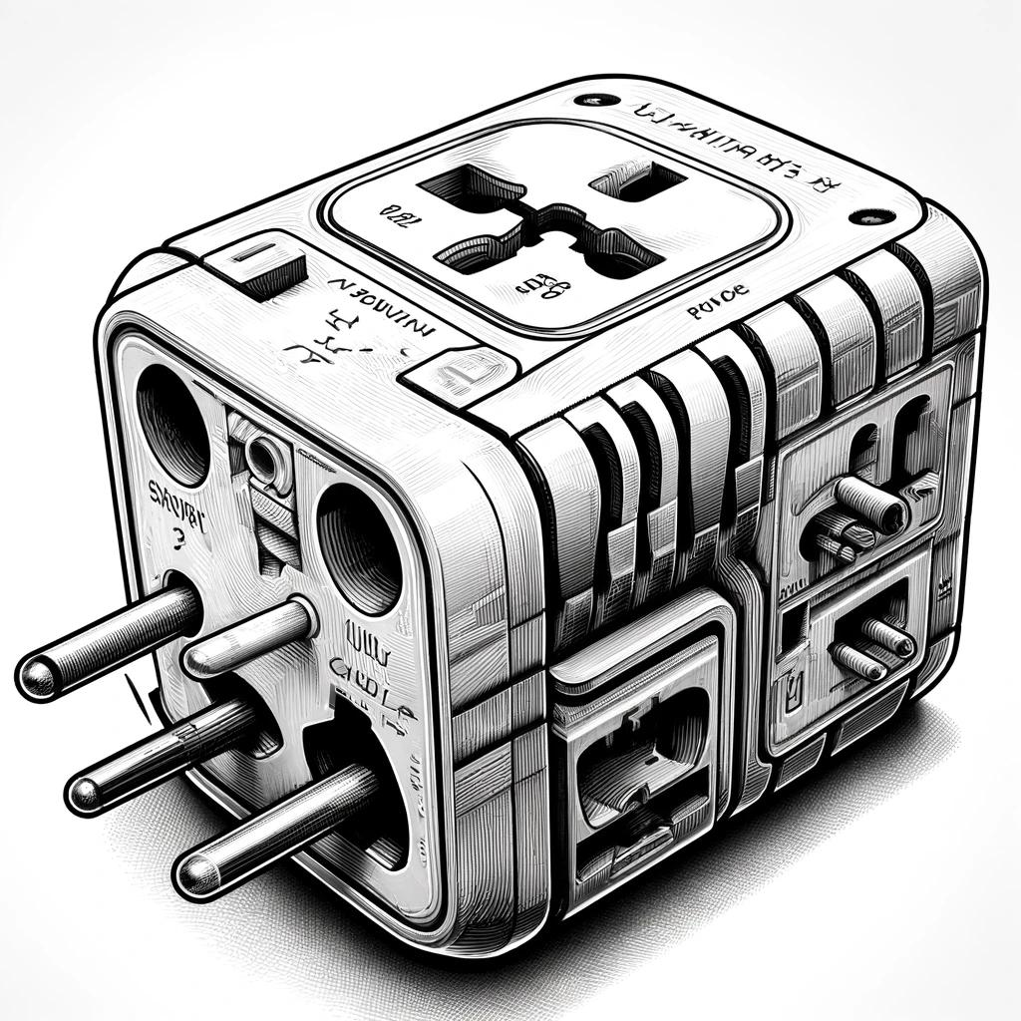


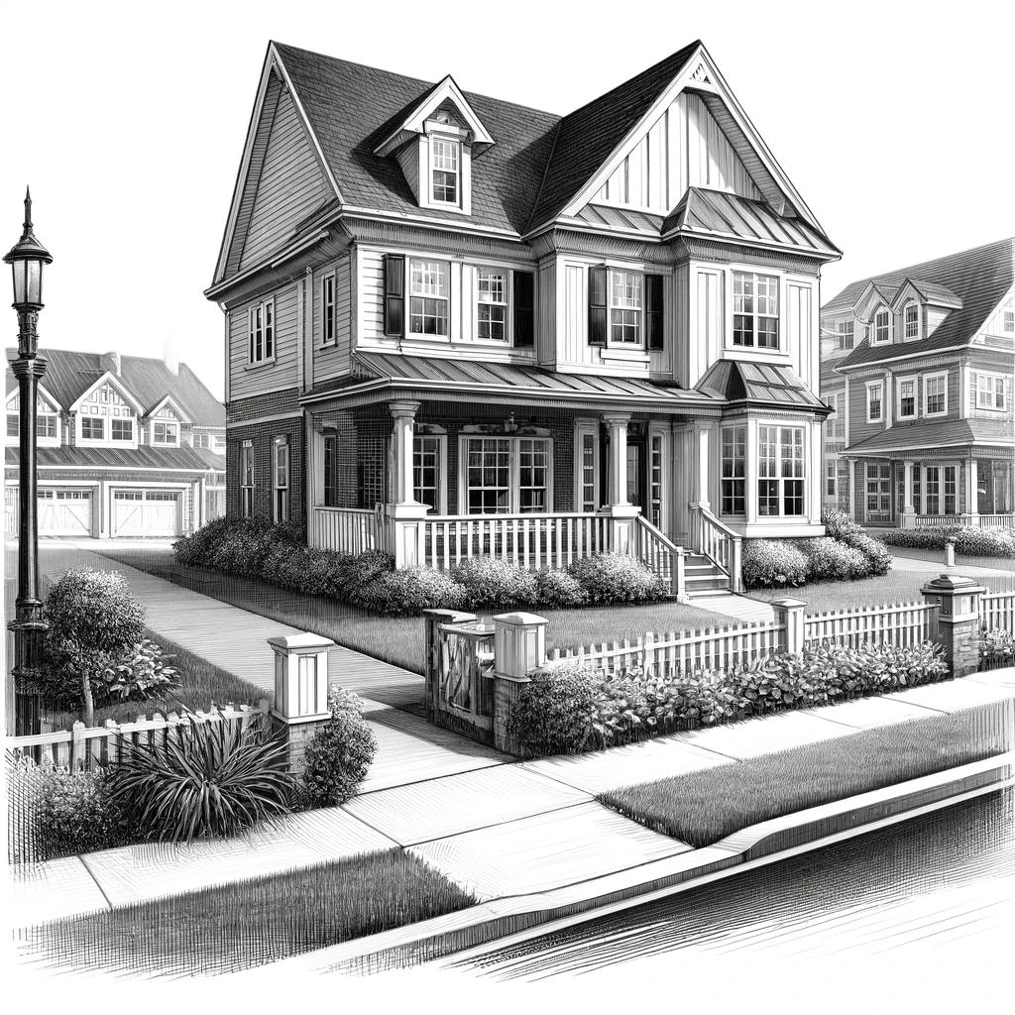

Some Examples From Reality

Slide 6
How to Learn?
Create a personal repository
Follow the video
Try it yourself
Don’t forget to document
Write short summary in code to remember

Slide 7

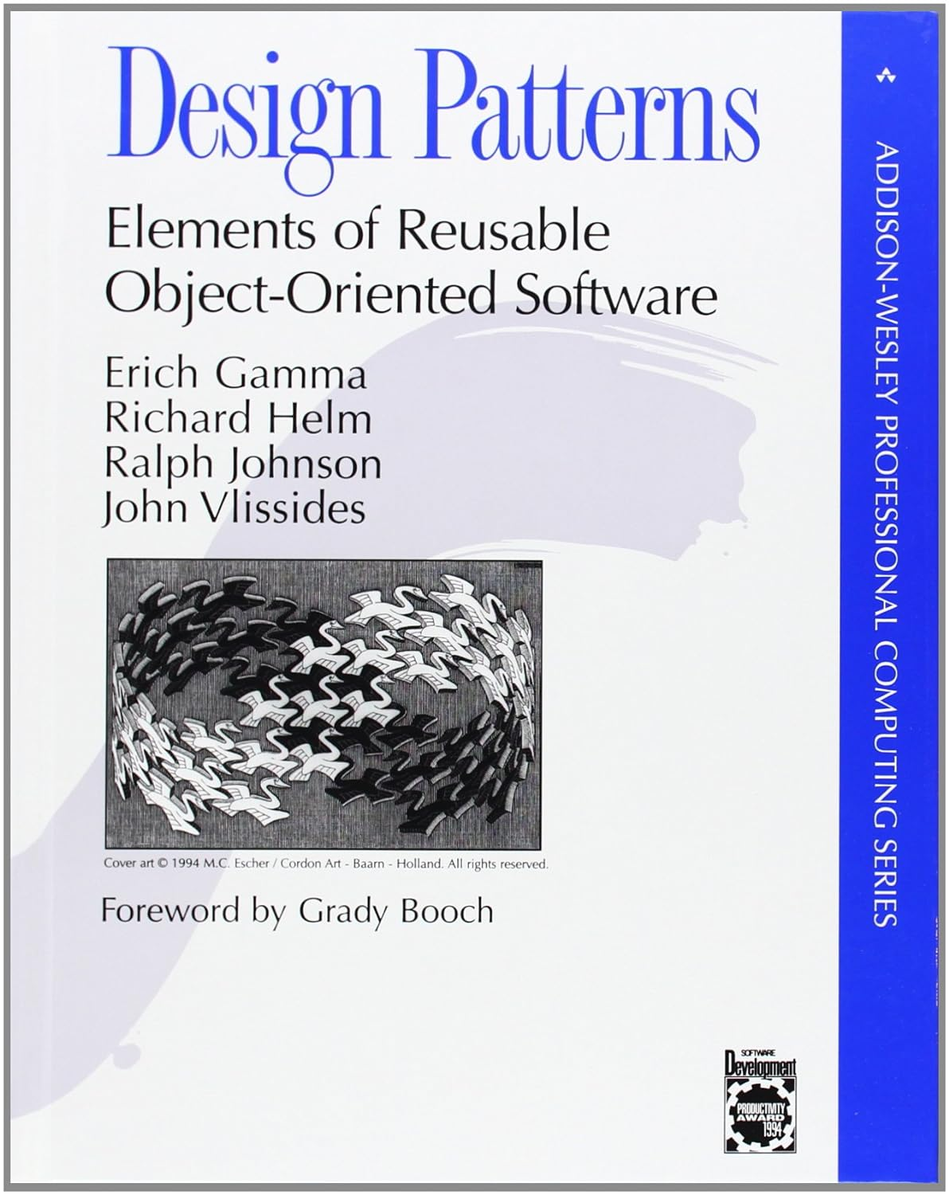
Sources
Head First Design Patterns: Building Extensible and Maintainable Object-Oriented Software 2nd Edition. Buy it on Amazon
Design Patterns: Elements of Reusable Object-Oriented Software.
Buy in on Amazon

Slide 8
Learning Steps
Description
General use case
Diagram
Code sample (Java)
Use case in test automation

Slide 9
My Secret Recipe
How I created each presentation WITH working code example in less than 15 minutes
How each chapter of this course was created:
Make a copy of the previous presentation and change the name to the next design pattern
Find the appropriate wikipedia page and copy the diagram
Use the following prompts in ChatGPT:
write a short paragraph about what is the XXX design pattern
list 6 example when this design pattern is useful
list some examples from the software test automation area
give an example of how this pattern can be useful for the XXXX use case [when writing selenium test automation scripts]
write a java code [selenium] example which demonstrate this use case

Slide 10
So, let’s get to work...

